Slide 1
Sales Forecasting & Anomaly Detection

Slide 2
agenda
Sales performance overview 3
sales forcasting and Seasonality 4
AI insights : Anomalities ,Influencers & Deocmposition 5
Executive summary and Business Recommendations 6

Slide 3
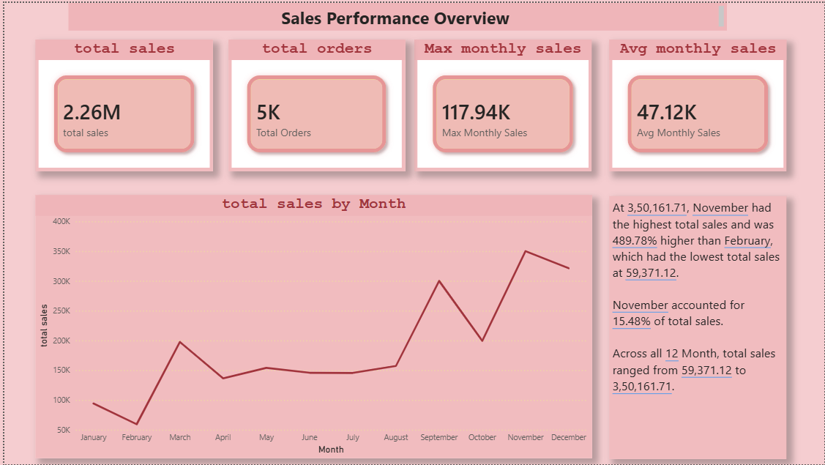
Sales Performance Overview
Make eye contact with your audience to create a sense of intimacy and involvement
Weave relatable stories into your presentation using narratives that make your message memorable and impactful
Encourage questions and provide thoughtful responses to enhance audience participation
Use live polls or surveys to gather audience opinions, promoting engagement and making sure the audience feel involved

Slide 4
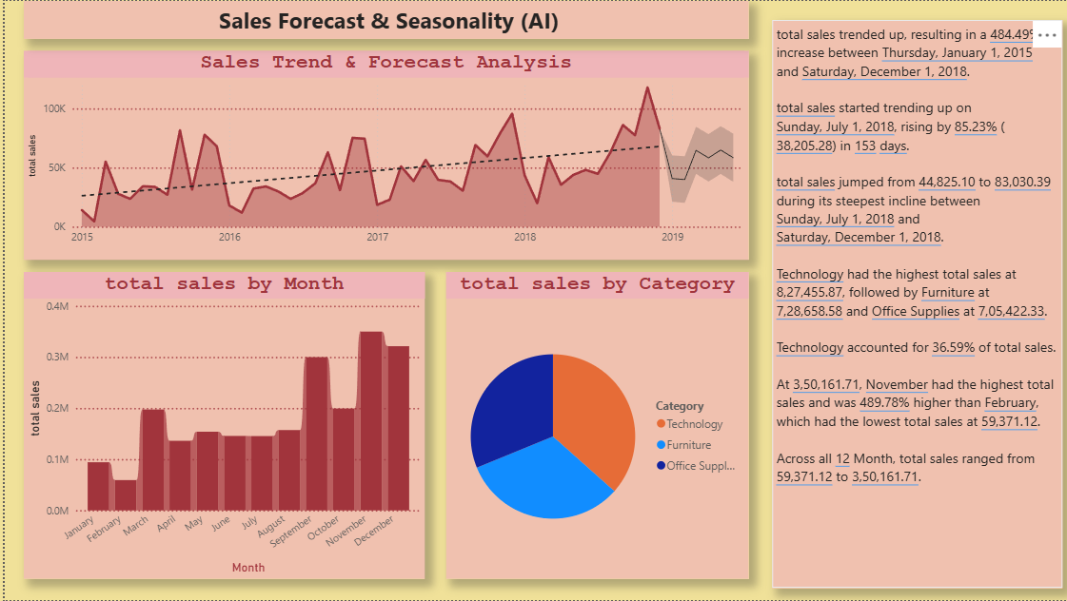
Sales Forecast & Seasonality (AI)
Make eye contact with your audience to create a sense of intimacy and involvement
Weave relatable stories into your presentation using narratives that make your message memorable and impactful
Encourage questions and provide thoughtful responses to enhance audience participation
Use live polls or surveys to gather audience opinions, promoting engagement and making sure the audience feel involved

Slide 5
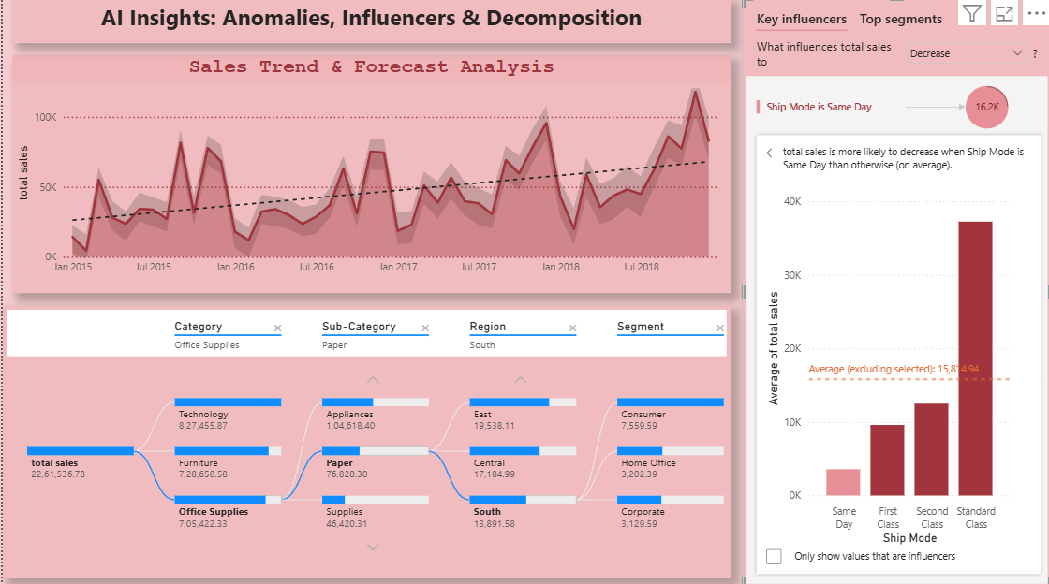
Sales Forecast & Seasonality (AI)
Make eye contact with your audience to create a sense of intimacy and involvement
Weave relatable stories into your presentation using narratives that make your message memorable and impactful
Encourage questions and provide thoughtful responses to enhance audience participation
Use live polls or surveys to gather audience opinions, promoting engagement and making sure the audience feel involved

Slide 6
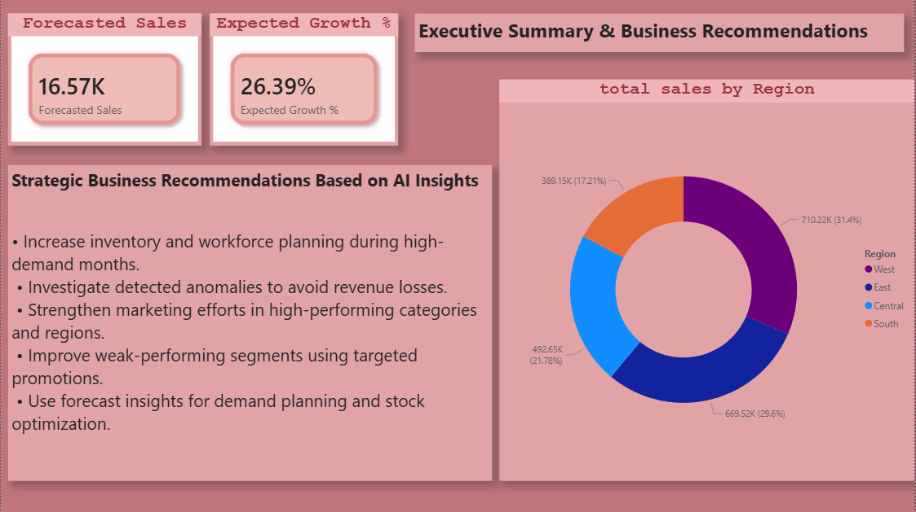
selecting visual aids
ENHANCING YOUR PRESENTATION

Slide 7
thank you

